Slide 1





Youtube Songs Analysis
By Heer Joshi

Slide 2
Overview
01
02
03
This internship project focuses on analyzing YouTube songs data using Power BI.
The goal is to uncover trends, preferences, and patterns.
Insights aim to help content creators and stakeholders optimize YouTube song content for better performance and user engagement.

Slide 3
Data Description
1. video_id: Unique identifier for each YouTube video.
2. channelTitle: Title of the YouTube channel publishing the song.
3. title: Title of the YouTube song video.
4. description: Description provided for the YouTube song video.
5. tags: Tags associated with the YouTube song video.
6. publishedAt: Date and time when the YouTube song video was published.
7. viewCount: Number of views received by the YouTube song video.
8. likeCount: Number of likes received by the YouTube song video.
9. favoriteCount: Number of times the YouTube song video has been marked as a favorite.
10. commentCount: Number of comments posted on the YouTube song video.
11. duration: Duration of the YouTube song video.
12. definition: Video definition or quality (e.g., HD, SD).
13. caption: Availability of captions for the YouTube song video

Slide 4
Objectives
01
02
03
04
05
Data Cleaning and Preparation
Exploratory Data Analysis (EDA)
Content and Channel Analysis
Temporal Trends
User Engagement Insights

Slide 5
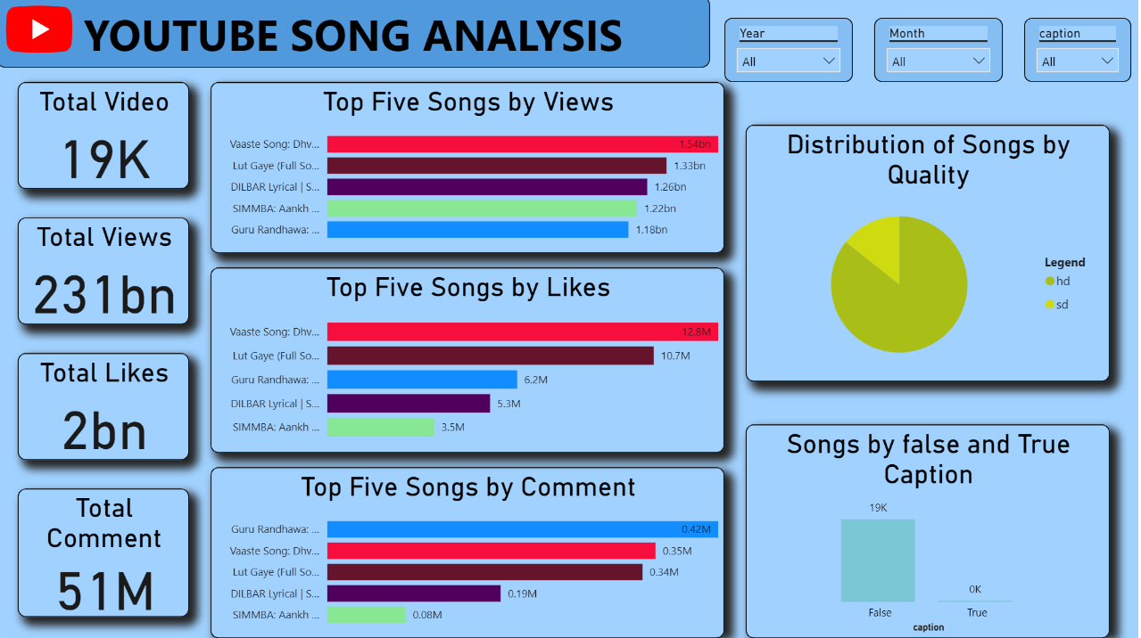
Dashboard 1

Slide 6
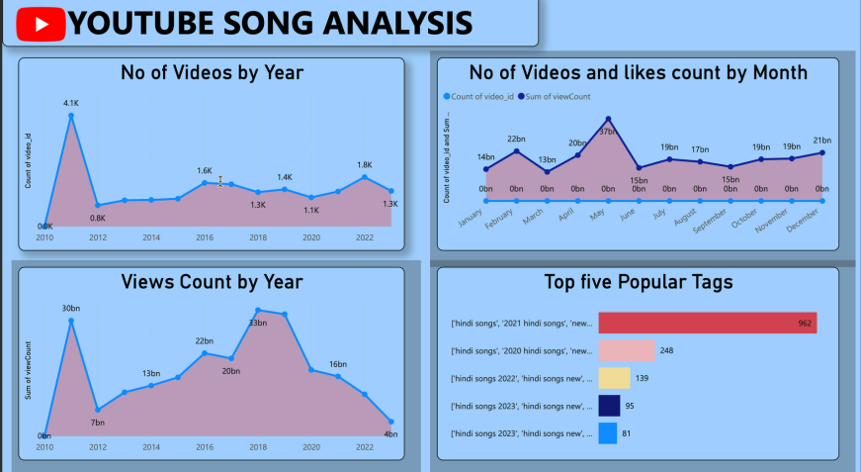
Dashboard 2

Slide 7
Insights
"Vaaste Song: Dhvani Bhanushali" leads in both views and likes, indicating high
popularity and engagement.
HD videos dominate with 85.72% preference, highlighting the importance of
producing high-quality content.
Engagement breakdown shows 99.25% of interactions are views, with likes and
comments making up a small fraction.
Annual song releases peaked in 2018, followed by a decline, suggesting a need
for a revised content strategy.
Average Metrics: 87.18K likes, 11.94M views, and 2.64K comments per song, showcasing significant viewer interaction

Slide 8
RECOMMENDATIONS
Content Strategy
Focus on HD Content
Continue producing and promoting HD videos to meet the high demand (85.72% preference).
Capitalize on Popular Songs
Analyze successful elements of "Vaaste Song" and "Lut Gaye."
Apply similar strategies in future content.
Investigate Decline in Releases
Analyze market trends and audience preferences post-2018.
Revitalize content release strategy based on findings.
Engagement Strategies
Enhance Engagement
Implement interactive features (polls, questions).
Use direct call-to-actions to encourage likes and comments.
Seasonal Release Strategies
Time releases around peak periods to maximize engagement.
.

Slide 9


Thanks
By Heer Joshi
joshiheer982@gmail.com
Github Link
Please keep this slide for attribution

